Slide 1
Fundamentals of Networks and Security
Vassilis Markos
Mediterranean College
Week 03

Slide 2
A Quick Revision

Slide 3
What we last time… 1 / n
Provide definitions for the following terms: Client, Host, Server, and Peer.
Client: The one who utilises data / services. Host: The one that keeps data / information. Server: The one the provides data / services. Peer: Someone at the same level to someone else.
Briefly describe how a client-server network works.
The servers offer services to the clients which, in term, use these services (essentially, the network is split to providers and consumers).

Slide 4
What we last time… 2 / n
What is a driver?
Software that is installed on each interested device within a network that interfaces with a target device (which corresponds to the driver).
What is a “Push”?
A “push” is the action of sending data directly from the server to a client, using the latter’s unique identifier (e.g., MAC address in a LAN network).
What is a “Pull”?
A “pull” is the action of accessing data from where they are kept by logging into a network.

Slide 5
What we last time… 3 / n
Is a Wireless Router the same as a WAP?
No, the wireless router creates a WAP, i.e., it enables us to connect to a network wirelessly, but a WAP is nothing more than that (i.e., it cannot perform any sort of routing).
Can a device act both as a client and as a server? If yes, name some use cases of such architectures.
Indeed, such networks where devices act as both providers and consumers are called Peer-to-Peer (P2P) networks and they are utilised in Blockchain, anonymous browsing, file-sharing etc.

Slide 6
What we last time… 4 / n
Name three examples of networks of different scale.
Home networks < Remote office networks < Corporate networks.
Regardless of network size, what is a common underlying principle for all networks?
All devices within the network must communicate in some way.
What is the recency effect in cognitive psychology?
When asked to recall items of a list in any order, people tend to remember the last members of the list better than the rest. This is called the recency effect. For more: https://en.wikipedia.org/wiki/Serial-position_effect

Slide 7
Protocols

Slide 8
Fast Things
Which of the following is the fastest?
You, after the end of the course?
Me, after the end of the course?
Light?
Light, of course, which travels with roughly 300,000 km/s, i.e., can travel from Athens to Thessaloniki back and forth 300 times in one second.

Slide 9
Messaging
Ways of direct communication:
Gestures.
Natural Languages.
Artificial Languages.
Pros and cons of the above?
Major drawback: You have to be visible / audible for the recipient of the message to receive it.

Slide 10
What about light?
Why not use light for messaging?
How can we convert messages to light?
Light beams cannot bend (but for gravitational lenses, but we are not studying theoretical physics at the moment…).
It has two states: visible (on) and not visible (off).
Security?

Slide 11
Problems difficult to solve
Why not use light for messaging?
How can we convert messages to light? Well, we can, but it is expensive in terms of time (and, hence, money) so we have to be really considerate with that
It has two states: visible (on) and not visible (off). For messaging at high speeds (i.e., 21st century speeds) we need to turn lights on and off really (really) fast. This, again, is hard to accomplish and we have devised several ways of making things faster (e.g., not turn the light entirely off)
Security? Let us forget about that for the moment…

Slide 12
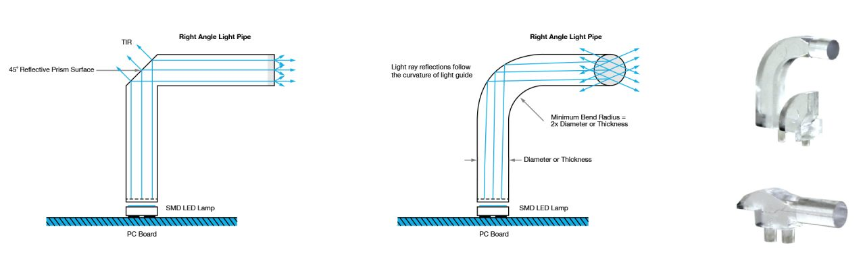
Problems easy to “go around”
More on light pipe design: https://vcclite.com/light-pipe-design-how-tir-refraction-come-into-play/

Slide 13
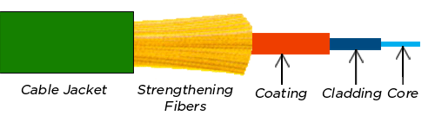
The anatomy of an optic fibre
Core: Where the light travels.
Cladding: Surrounds the core to keep light there via “total internal reflection”.
Coating: Reinforces its internals, usually plastic.
Strengthening fibers: “Cushion” that protects the core against tensions.
Cable Jacket: More protection (from the environment, us etc).

Slide 14
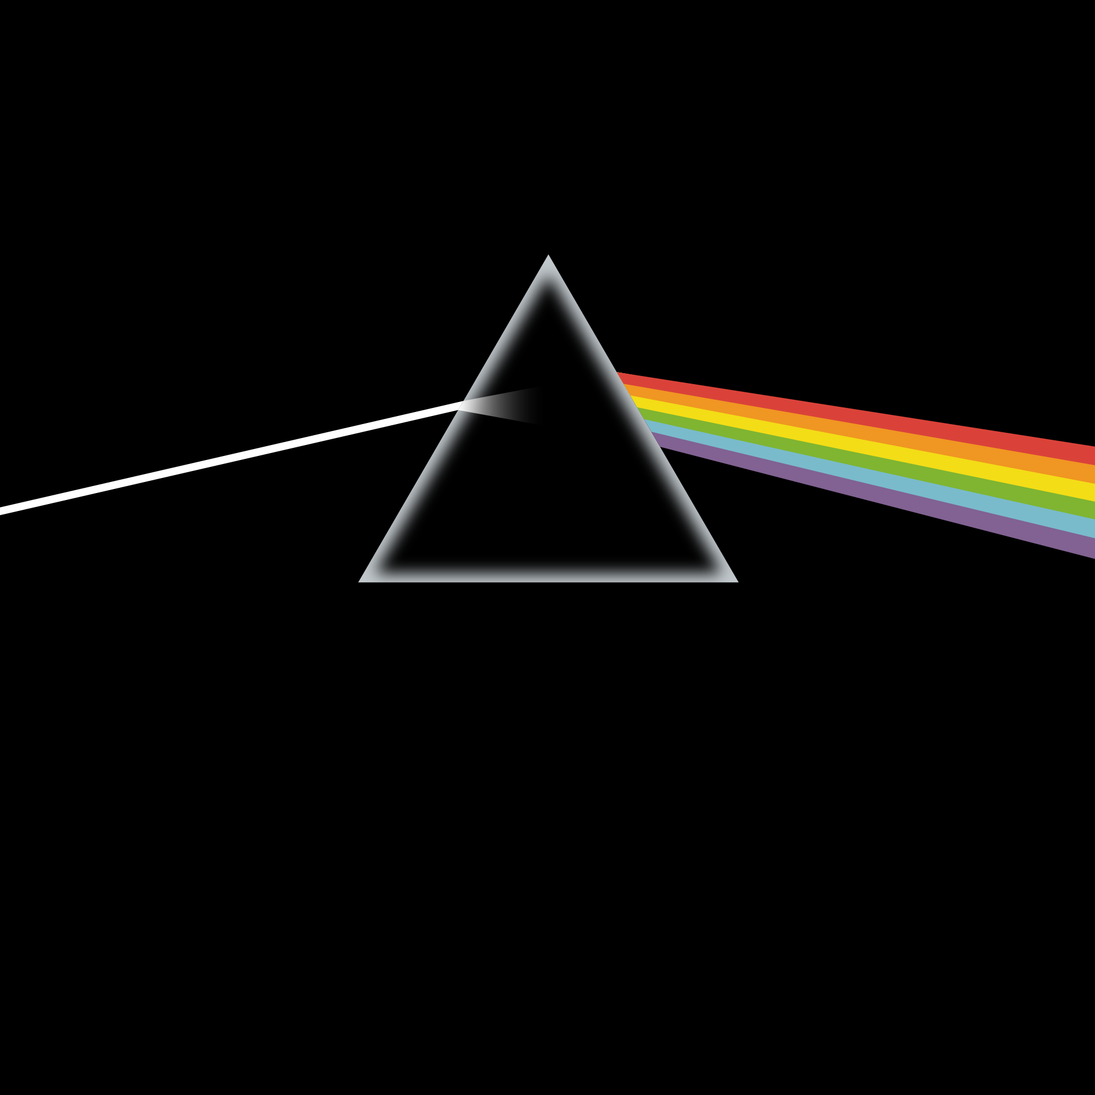
How many modes ( = colours)?
Monomode fibre | Multimode fibre
Driven by expensive laser | Driven by cheaper lasers
Pure light (one colour) | Many similar colours
Long distance, high bandwidth | Long distance, high bandwidth
Expensive (to buy and install) | Expensive (a bit less)
Really fragile | Fragile (a bit less)
Dangerous | Less dangerous
Hard to terminate | Not so hard to terminate

Slide 15
What about the good old copper?
Coax cables: Really old, barely used, especially not in LAN.
Twisted pairs: Typical in networks (they come in CATegory numbers)
Typical structure: 4 pairs of twisted wire, all twisted together.
Signals are sent through voltage differences between two conductors.
They can work as antennas (receive and transmit signals).
But, why twisted?

Slide 16
Radio waves
In typical radios, changing the voltage changes the radio station you are tuned into.
Having two wires close to each other may result to them receiving the same signal at different time (RFI = Radio Frequency Interference and EMI = Electro Magnetic Interference).
Can you see a problem with the above?
This may result to destroyed / corrupt signals.
How to fix it?
Twisting them together brings them really close.
Twisting also brings alternately either wire to the “front”, so they hopefully receive the same signals.

Slide 17
Twist-ception
We have twisted pairs twisted together. Why not keep this up?
We actually do, twisting twisted twisted pairs together to minimise EMI and crosstalk.
Crosstalk is any phenomenon by which a signal transmitted on one circuit or channel of a transmission system creates an undesired effect in another circuit or channel. Crosstalk is usually caused by undesired capacitive, inductive, or conductive coupling from one circuit or channel to another.

Slide 18
Why not drop wires?
Wireless connections are implemented by signals travelling through space.
Not the air! EMs can travel through the empty space!
But, what about security?
Well, let’s leave this for the future…
Carrier frequencies (i.e., wireless connection EM frequencies):
2.4 GHz (roughly microwave oven frequency).
5 GHz (microwaves, but not the oven ones).
6 GHz (once popular, then forgotten, now popular again).
Devices did not use to support many carrier frequencies. Now they often do.

Slide 19
Network Infrastructure Devices
Network Access Devices:
Switches (Layer 2)
WAP (Layer 2 and Layer 1, when it comes to their wireless part).
Internetworking Devices:
Routers (Layer 3)
Wireless Routers (Layer 3 but also Layer 1 and Layer 2)
Security Devices:
Firewalls (Layer 4 but often Layer 3 or even higher layers)
All these devices perform different functions and, hence, cannot work in place of one another. Thus, they are not interchangeable!

Slide 20
WAP vs Wireless Router
What is the difference between a WAP and a Wireless Router?
WAP connects wireless clients to a local network.
Wireless Routers connect wireless clients to another network.
In general, routers of any type make a network visible to other networks, while AP make “the local network” visible to other clients within the same network.

Slide 21
Ports
Physical ports: The holes on a device where we connect a cable.
Logical ports: Communication identifiers for several stuff. E.g., WWW is on port 80.
Typically, ports range from 0 to 65535.
So, typically, how many ports are there available?
65536
But, why only that many? Does 65536 ring a bell?
Take into account that 65536 = 2¹⁶…
…and the fact that TCP uses 16 bits to encode port numbers, so…
…2¹⁶ = 65536 options.

Slide 22
Inter-LAN equipment
Routers usually have 2-4 physical ports (go home and check your own router).
Enterprise routers (those used by ISP) tend to have more, but they are way more expensive.
One of router’s jobs is to translate between different connection protocols:
ADSL
Cable broadband
Ethernet LAN
Wireless LAN
Typical Layer 3 switches have ethernet ports (12 - 24).

Slide 23
Networks of different sizes
PAN: Personal Area Network
LAN: Local Area Network
WLAN: Wireless LAN
SAN: Storage Area Network
MAN: Metropolitan Area Network
WAN: Wide Area Network
Wireless variants of the above…

Slide 24
Homework
Using any resources you wish (course material, books, papers, online resources etc), write a 300-400 words essay on about typical connection media encountered in networks. Among others, you might consider elaborating on what we have presented in today’s lecture, i.e.:
Fibre
Copper
Wireless
Submit your essays at: v.markos@mc-class.gr

Slide 25
(Reminder) NetAcad Courses
In the “Download Packet Tracer” page, above the “Download” section, you can find three interesting courses (interesting course: a course is characterised as “interesting” to inform someone that they should take it, without telling them to do so directly):
Getting Started with Cisco Packet Tracer
Exploring Networking with Cisco Packet Tracer
Exploring IoT with Cisco Packet Tracer
Also interesting is the following NetAcad course:
Network Technician

Slide 26
What we saw today… 1 / n
What is the speed of light?
300,000 km/s
Name some drawbacks of using light as a means of messaging.
Some drawbacks are:
How can we convert messages to light?
Light beams cannot bend (but for gravitational lenses, but we are not studying theoretical physics at the moment…).
It has two states: visible (on) and not visible (off).
Security?

Slide 27
What we saw today… 2 / n
Name the key parts of an optic fibre.
The core parts of an optic fibre are:
Core: Where the light travels.
Cladding: Surrounds the core to keep light there via “total internal reflection”.
Coating: Reinforces its internals, usually plastic.
Strengthening fibers: “Cushion” that protects the core against tensions.
Cable Jacket: More protection (from the environment, us etc).

Slide 28
What we saw today… 3 / n
Name some differences and similarities of mono- and multi-mode fibres.
Some similarities are:
Both can transmit messages to long distance and a high bandwidth.
They are fragile.
They are expensive to buy and install.
Some differences are:
Monomode fibres comprises of a single mode light, while multimode ones from multiple similar modes.
Monomode light is driven by expensive lasers compared to multimode.
Monomode light is hard to terminate while multimode is not.

Slide 29
What we saw today… 4 / n
Having two copper cables close together may result to corrupt signals. How can we fix it?
By twisting cables together we manage to minimise RFI and EMI, thus minimising corrupt signals. Moreover, through twisting both cables are alternately coming closer to the signal source, thus further reducing the chance of RFI / EMI.
What is the difference between WAP and Wireless Router?
In general, routers of any type make a network visible to other networks, while AP make “the local network” visible to other clients within the same network.

Slide 30
What we saw today… 5 / n
Name some types of networks.
Some types of networks include:
PAN: Personal Area Network
LAN: Local Area Network
WLAN: Wireless LAN
SAN: Storage Area Network
MAN: Metropolitan Area Network
WAN: Wide Area Network
Wireless variants of the above…

Slide 31
Fun Time!

Slide 32
Lab 1: TCP/IP and OSI Models
In this Lab we (i.e., you) will explore some stuff we will formally discuss next week.
Open ‘Tutorial_Lab > Week 3 Tutorial - Investigating the TCP-IP and OSI Models in Action.pdf’ and follow the instructions there.
If you want a quick reminder on WireShark, follow the tutorial found in: ‘Tutorial_Lab > Week 3 Tutorial - Using Wireshark to View Network Traffic - ILM.pdf’.

Slide 33

Any Questions?
Don’t forget to fill-in the questionnaire! (look right)
https://forms.gle/6q2tuByroaan8kWH8

